Slide 1

BASIC ELECTRONICS AND ELECTRICAL ENGINEERING
BY- CHANDANA MN (CSE-087)
HARSHITHA MASUR(AE-016)
PRIYANKA HANSDA(AE-009)
ASSIGNED BY- DR.HARINATH AIREDDY

Slide 2
MEASUREMENT OF RESISTANCE USING COLOR CODING AND MULTIMETER

Slide 3
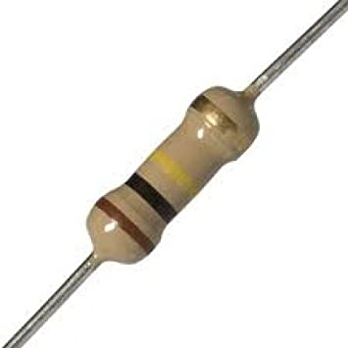
Resistor
A resistor is a passive two-terminal electrical component that implements electrical resistance as a circuit element.

Slide 4
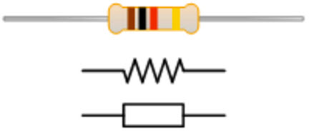
Resistor Symbol

Slide 5
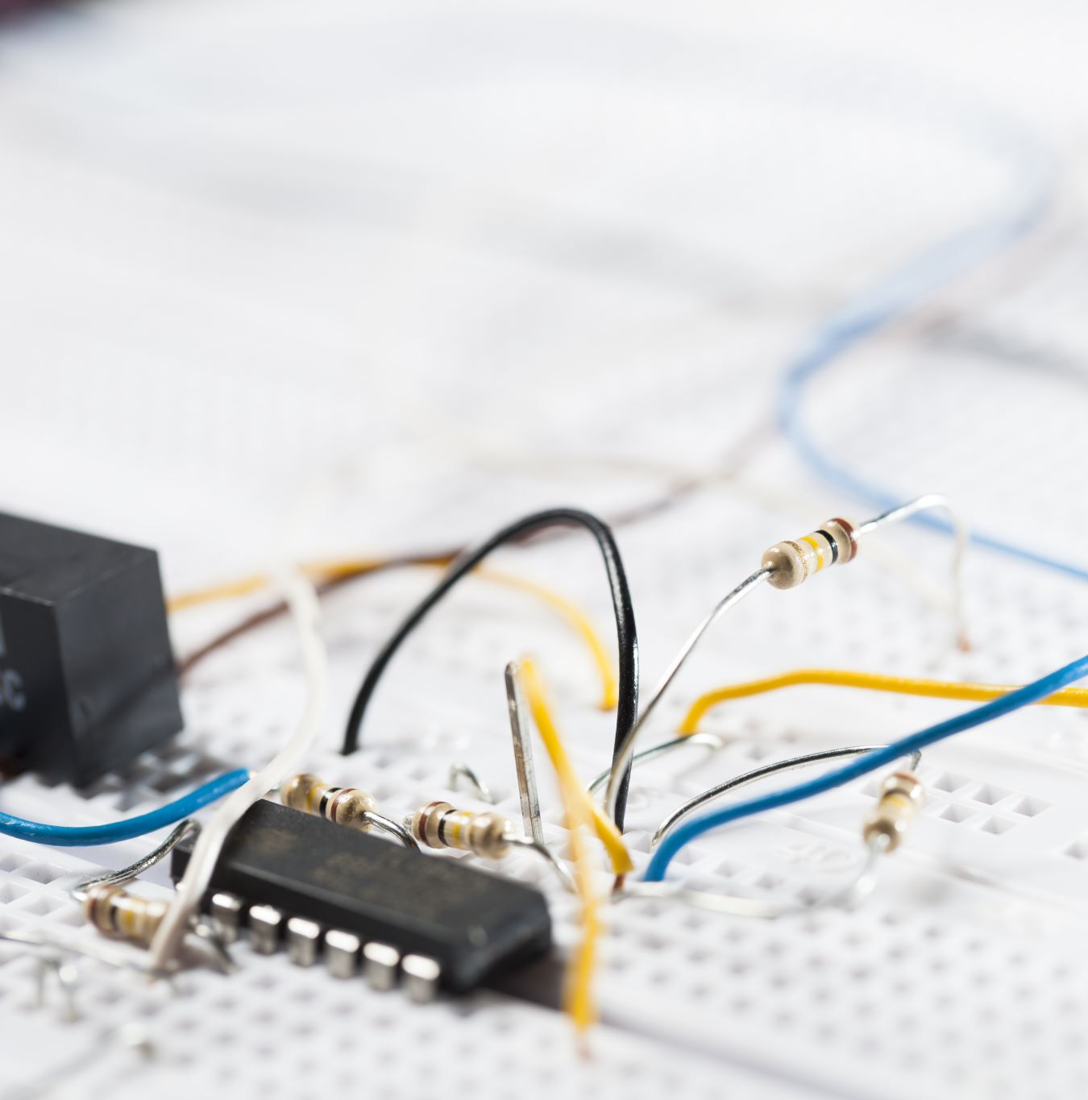
Unit of Electrical resistance
Unit=Ohm
Symbol=Ω

Slide 6
Color Codes
Color | Digit | Multiplier | Tolerance (%)
Black | 0 | 10⁰(1)
Brown | 1 | 10¹ | 1
Red | 2 | 10² | 2
Orange | 3 | 10³
Yellow | 4 | 10⁴
Green | 5 | 10⁵ | 0.5
Blue | 6 | 10⁶ | 0.25
Violet | 7 | 10⁷ | 0.1
Grey | 8 | 10⁸
White | 9 | 10⁹
Gold |  | 10⁻¹ | 5
Silver |  | 10⁻² | 10
(none) |  |  | 20

Slide 7
SHORT CUT TO REMEMBER THE COLOUR CODE
B.B.ROY Gone to Bangalore WIth Gorgeous Wife to buy Gold and Silver and returned with No money.
B.B. Roy of Great Britain Veto Getting Wed.

Slide 8

NOW LET US GO TO THE EXPERIMENT

Slide 9

Aim:
To calculate the value of Resistor using color coding and Multimeter

Slide 10
Apparatus Required:
Sl.No | Equipment | Range | Quantity
1 | Color-coding chat | - | -
2 | Resistors | - | 5 to 6
3 | Multimeter | - | 1

Slide 11
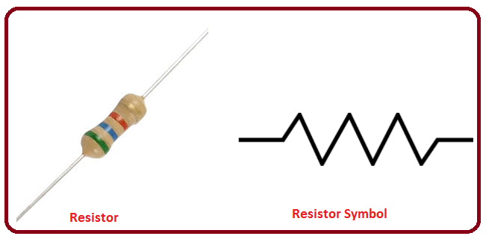
Theory:
Resistor is a passive electronic component, which exhibits the property of the ‘Resistance’.
Resistance is a physical property of the material, which opposes the flow of current.
Resistors are used in circuits to limit the flow of current or to provide a voltage drop.
Unit: Ohms (Ω) Symbol:
R

Slide 12
Resistors are broadly classified in to two categories as
1) Fixed Resistors
2) Variable Resistors

Slide 13
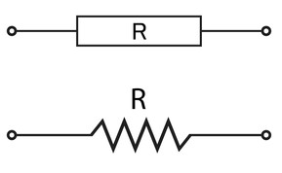
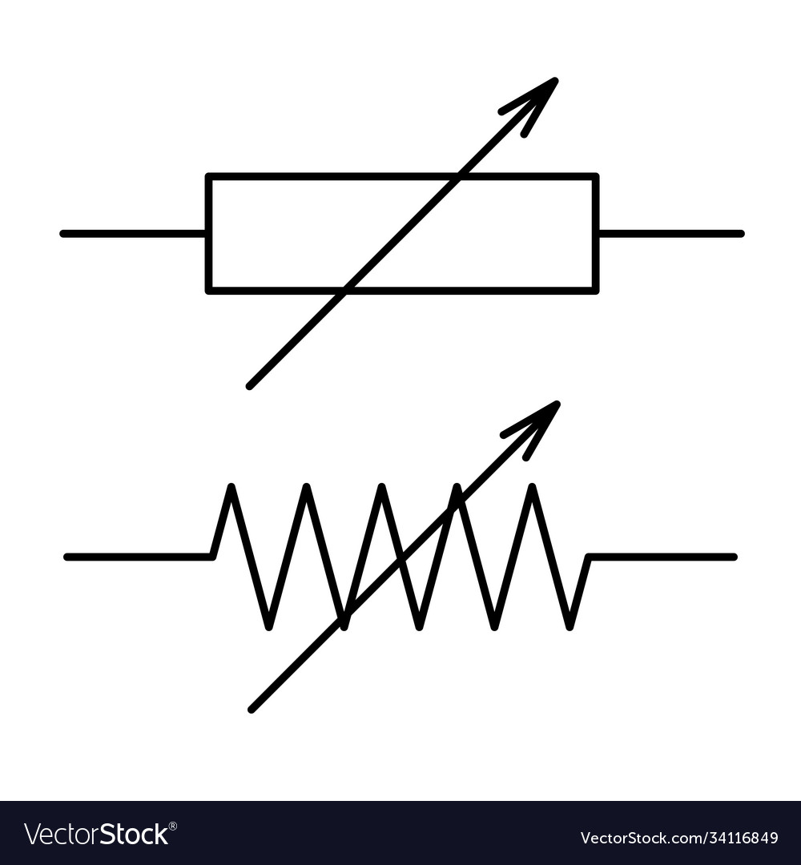
Fixed Resistors:
Variable Resistors:
Fixed resistors are those whose values cannot be changed after manufacturing.
Variable resistors are those whose values can be changed after manufacturing.
R
R

Slide 14
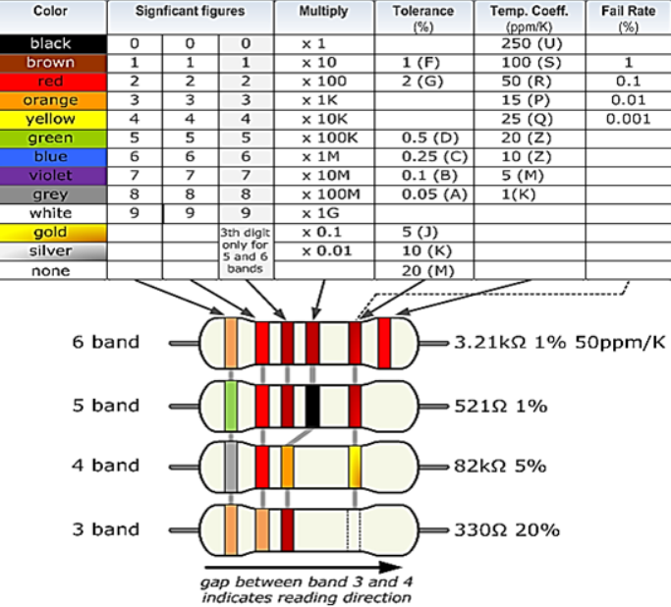
Color Coding Chat:

Slide 15
Observation Table:
Sl. No | 1 ^{st} band | 2 ^{ND} band | 3 ^{rd} band | 4 ^{th} band | Using color coding chart | Using Multimeter | Remarks
1
2
3
4
5
6

Slide 16
Procedure:
1. Consider a given resistor for color coding.
2. Direction of color band of resistor from left to right and tolerance band always at right side.
3. With the help of resistor color coding chart/table. Assign the value for the suitable color.
4. Calculate the value of given resistor. And also verify the value of resistor using multimeter.
5. Repeat the same for 5 to 6 resistors.

Slide 17
Result:
Calculated the value of resistor using color coding chart and verified the same with multimeter.

Slide 18


